Slide 1
Immunotherapy and Mismatch Repair Deficiency
Dott. VINCENZO de falco, md, pHD
Università della campania
«LUIGI VANVITELLI»

Slide 2
State of art for dMMR locally advanced rectal cancer until October 2023
dMMR tumors: ~10% of early-stage disease
Rectal cancer usually treated by total mesorectal excision (TME) +/- neoadjuvant treatment that can lead to organ preservation:
• <30% in intermediate (N+) – locally advanced disease(T4, MRF+)
• 60% in early-stage disease (max 4cm and no lymph node involvement)
Relative resistance to chemotherapy

Slide 3
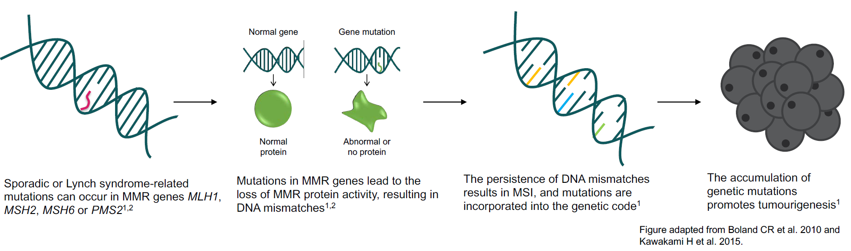
dMMR/MSI-High cancers
1. Boland CR et al. Gastroenterology 2010;138:2073–2087; 2. Kawakami H et al. Curr Treat Options Oncol 2015;16:30.

Slide 4
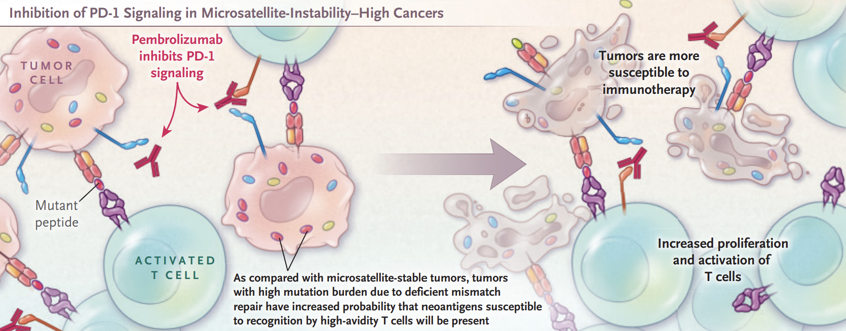
dMMR/MSI-High cancers and PD-1 inhibitors
First FDA Approval Agnostic of Cancer Site — When a Biomarker Defines the Indication, Lemery et al., NEJM 2017

Slide 5
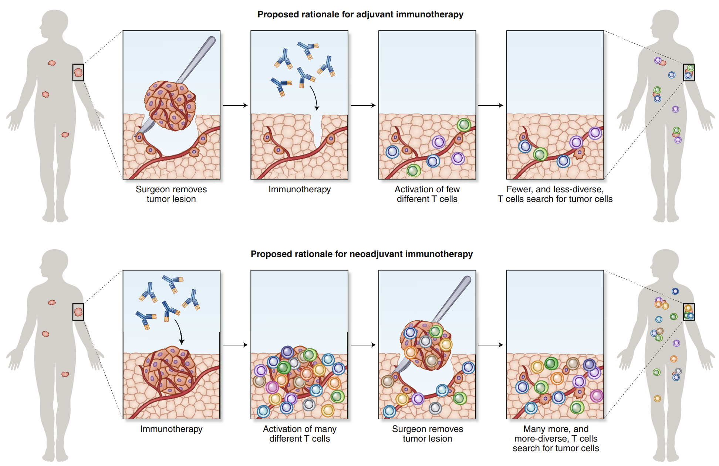
Scientific rationale for neoadjuvant immunotherapy
• Larger amount of antigens
• Tumor draining lymph nodes in situ
• Larger pool of tumor-reactive T cells + expansion of more tumor-resident T cell clones

Slide 6
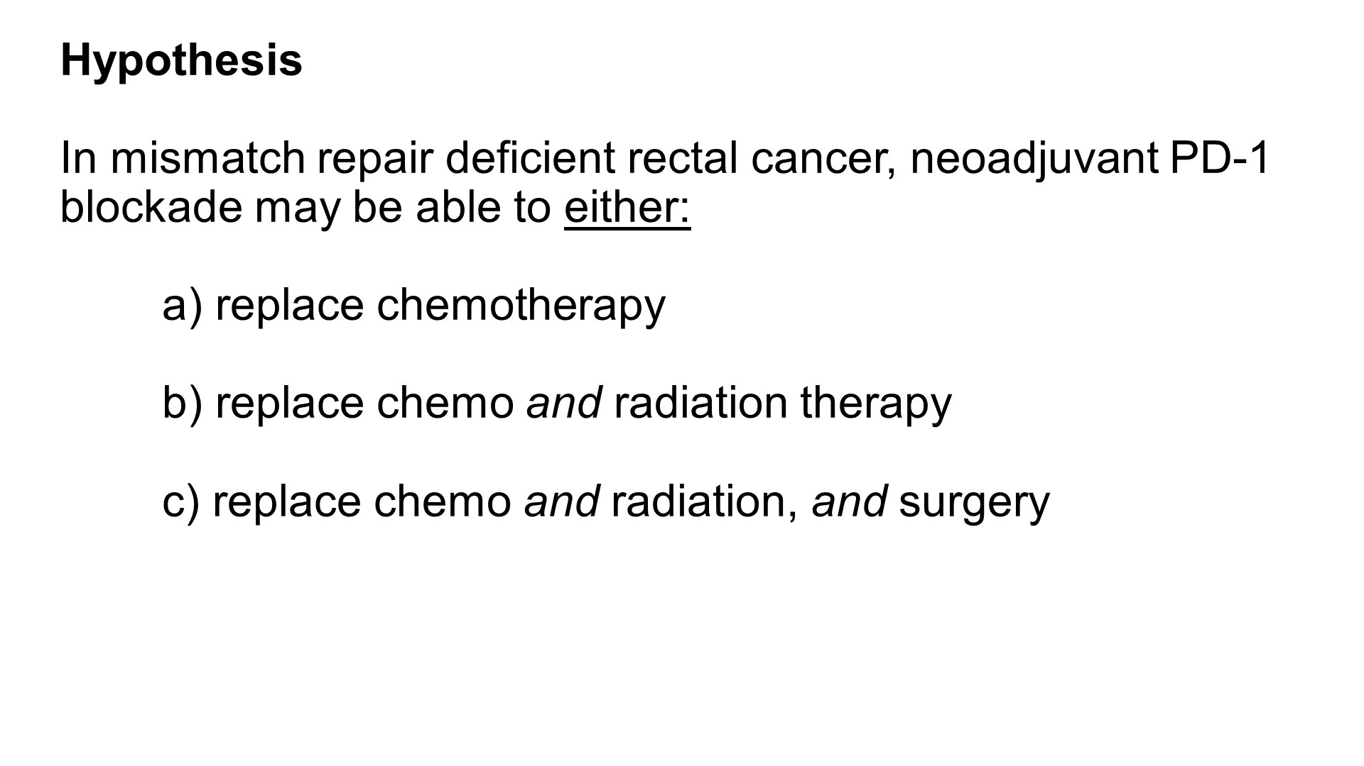

Slide 7
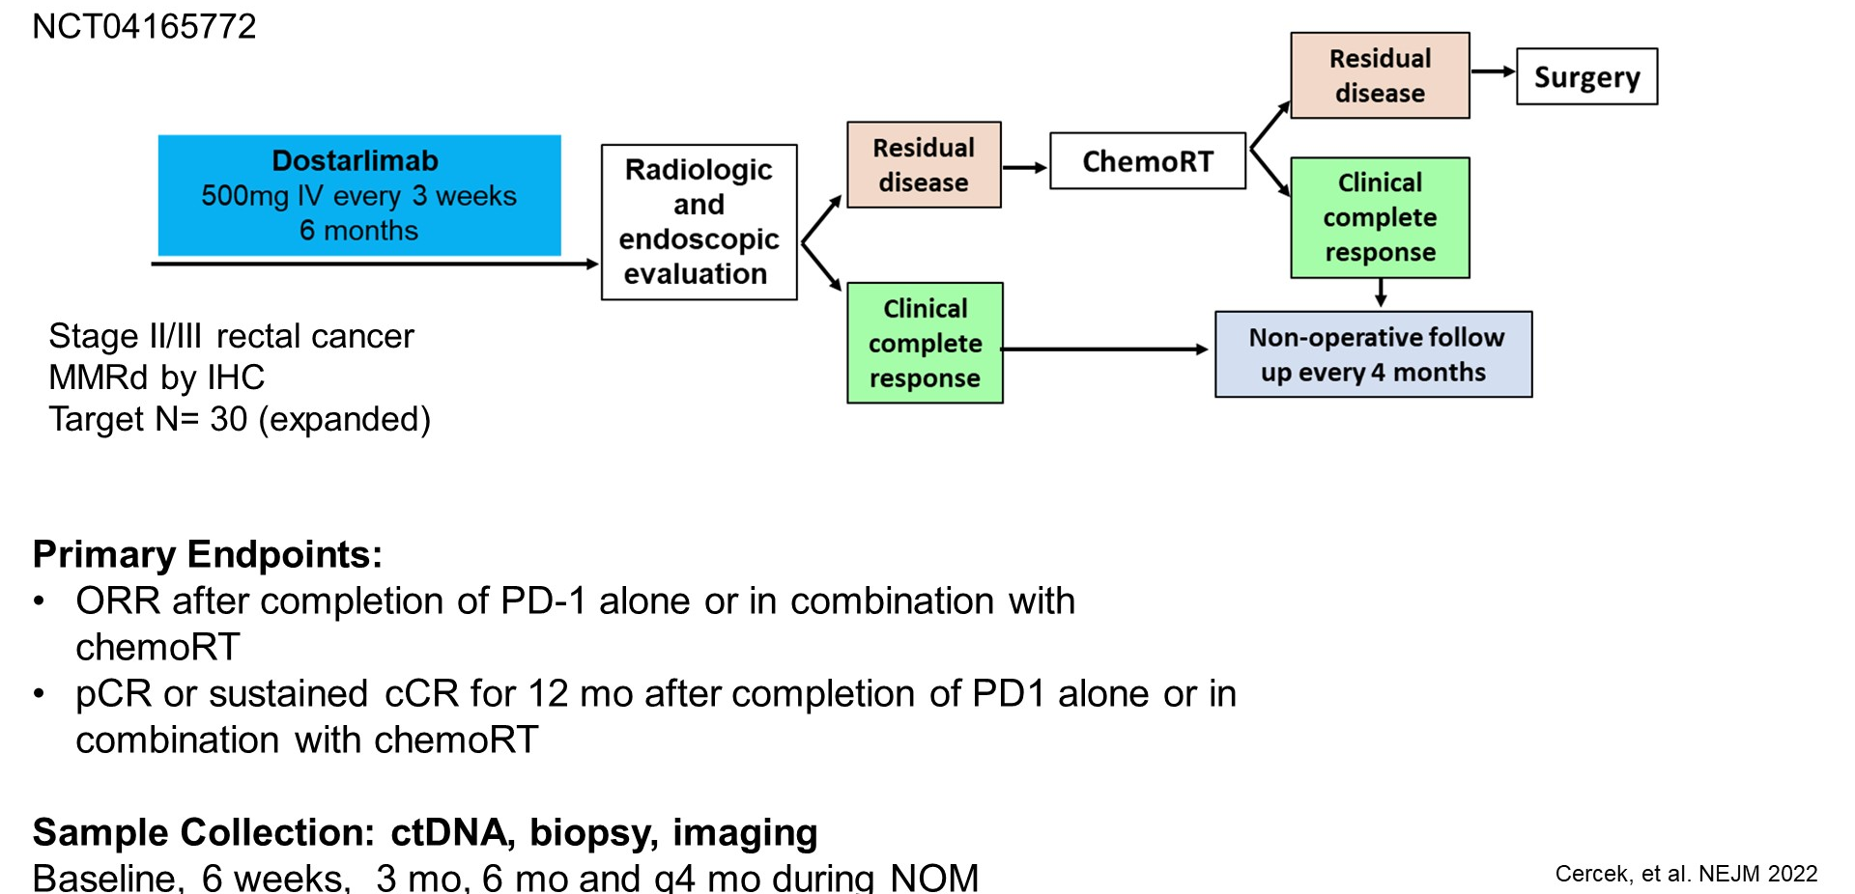
Neoadjuvant PD-1 blockade in dMMR locally advanced rectal cancer

Slide 8
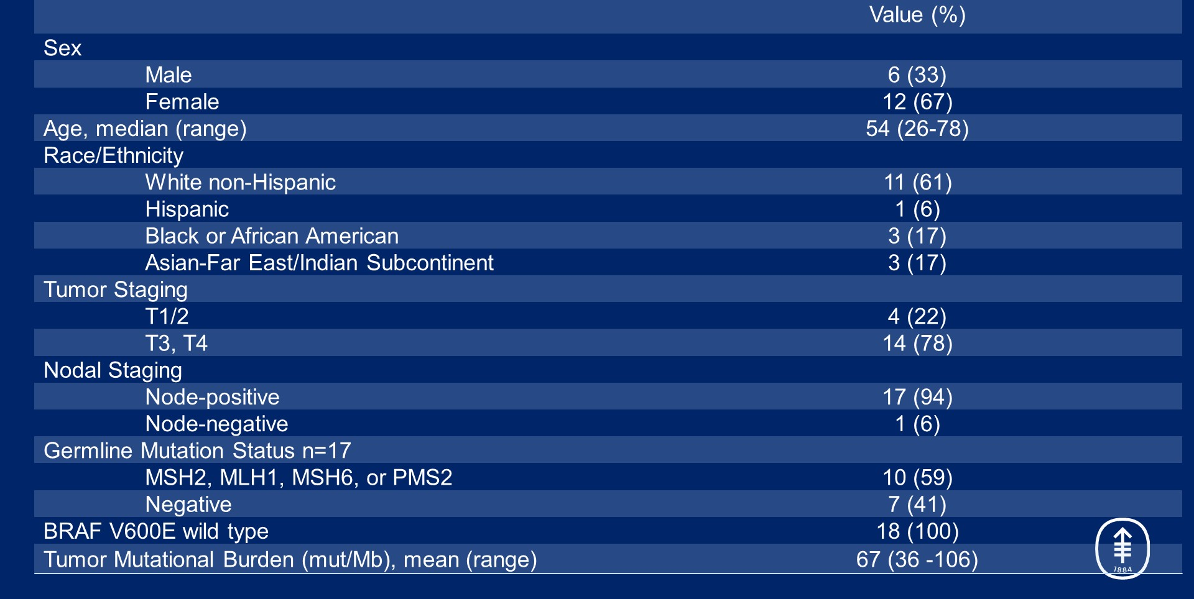
Demographic and disease characteristics of the patients at baseline
Cercek, ASCO 2022

Slide 9
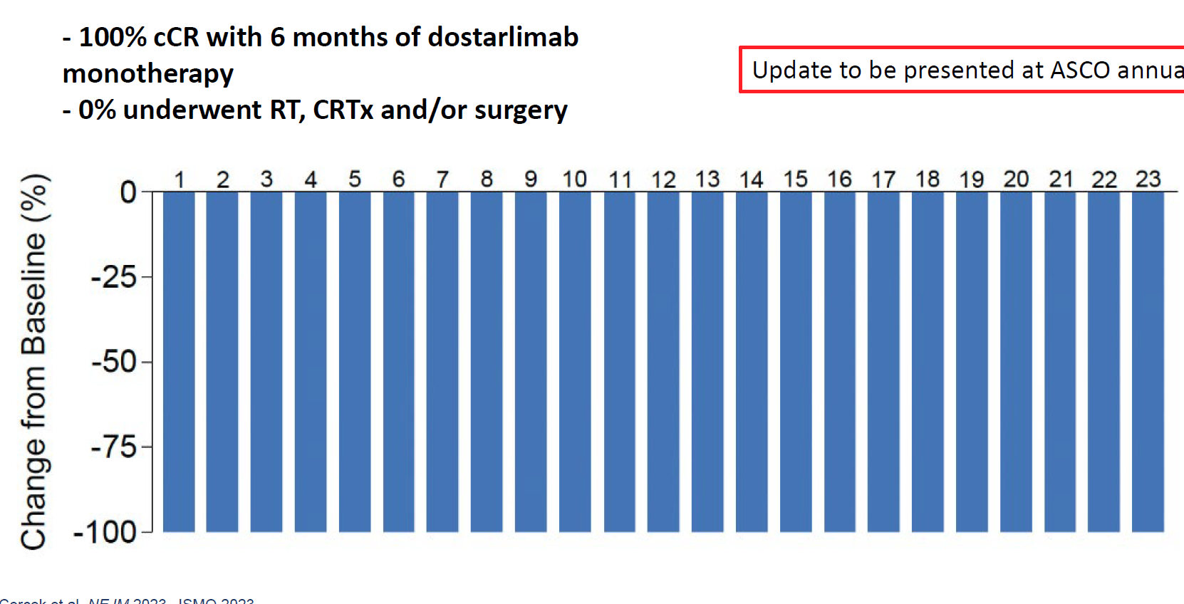
Overall response rate after six months of dostarlimab
Cercek, ASCO 2022
Notes:
the response criteria, so clinical complete response criteria for rectal cancer have been well defined and they include endoscopic exam, which is a visual disappearance of the rectal primary and a normal digital rectal exam, as well as evaluation of an MRI with lack of signal with DWI, and then regression of target lymph nodes.

Slide 10
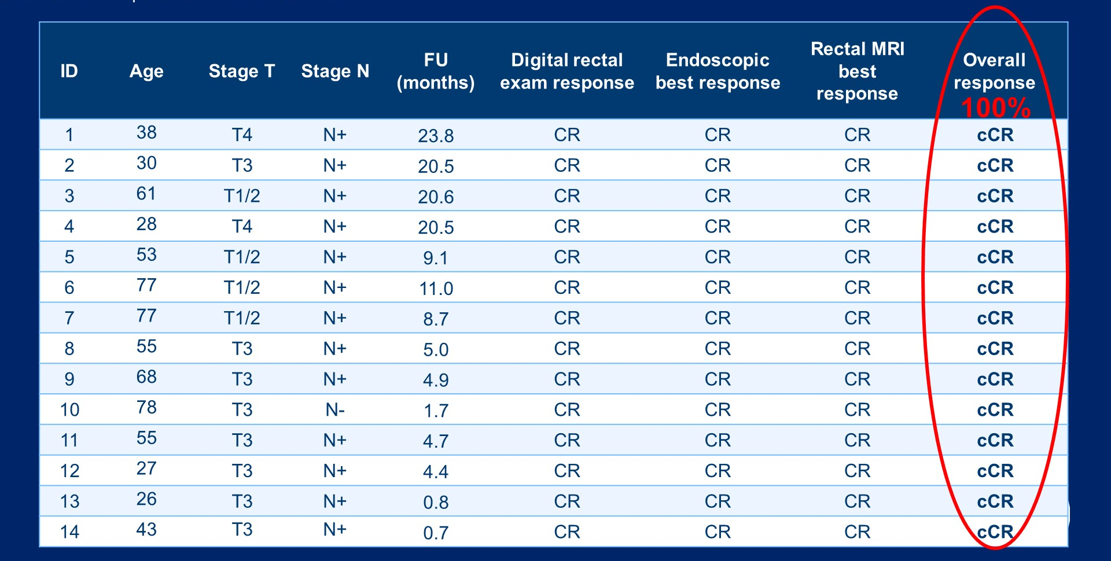
Overall response rate after six months of dostarlimab
Cercek, ASCO 2022

Slide 11
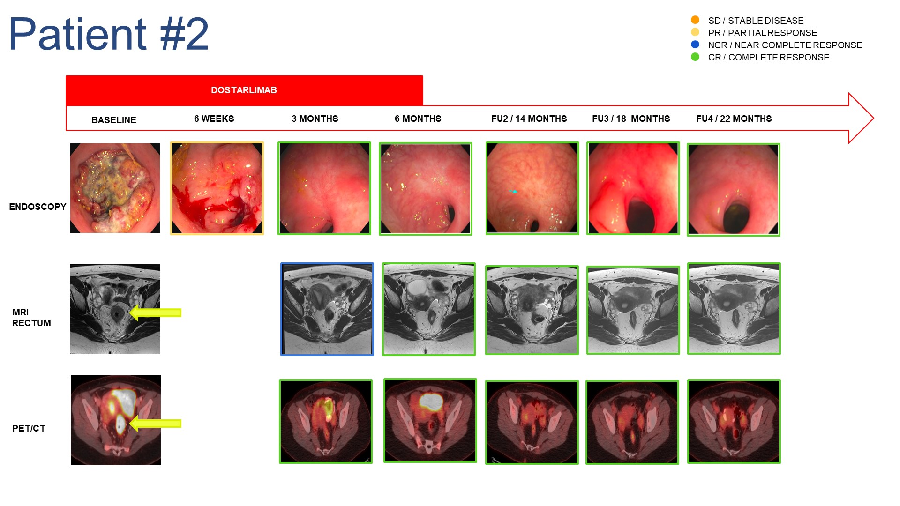
Cercek, ASCO 2022

Slide 12
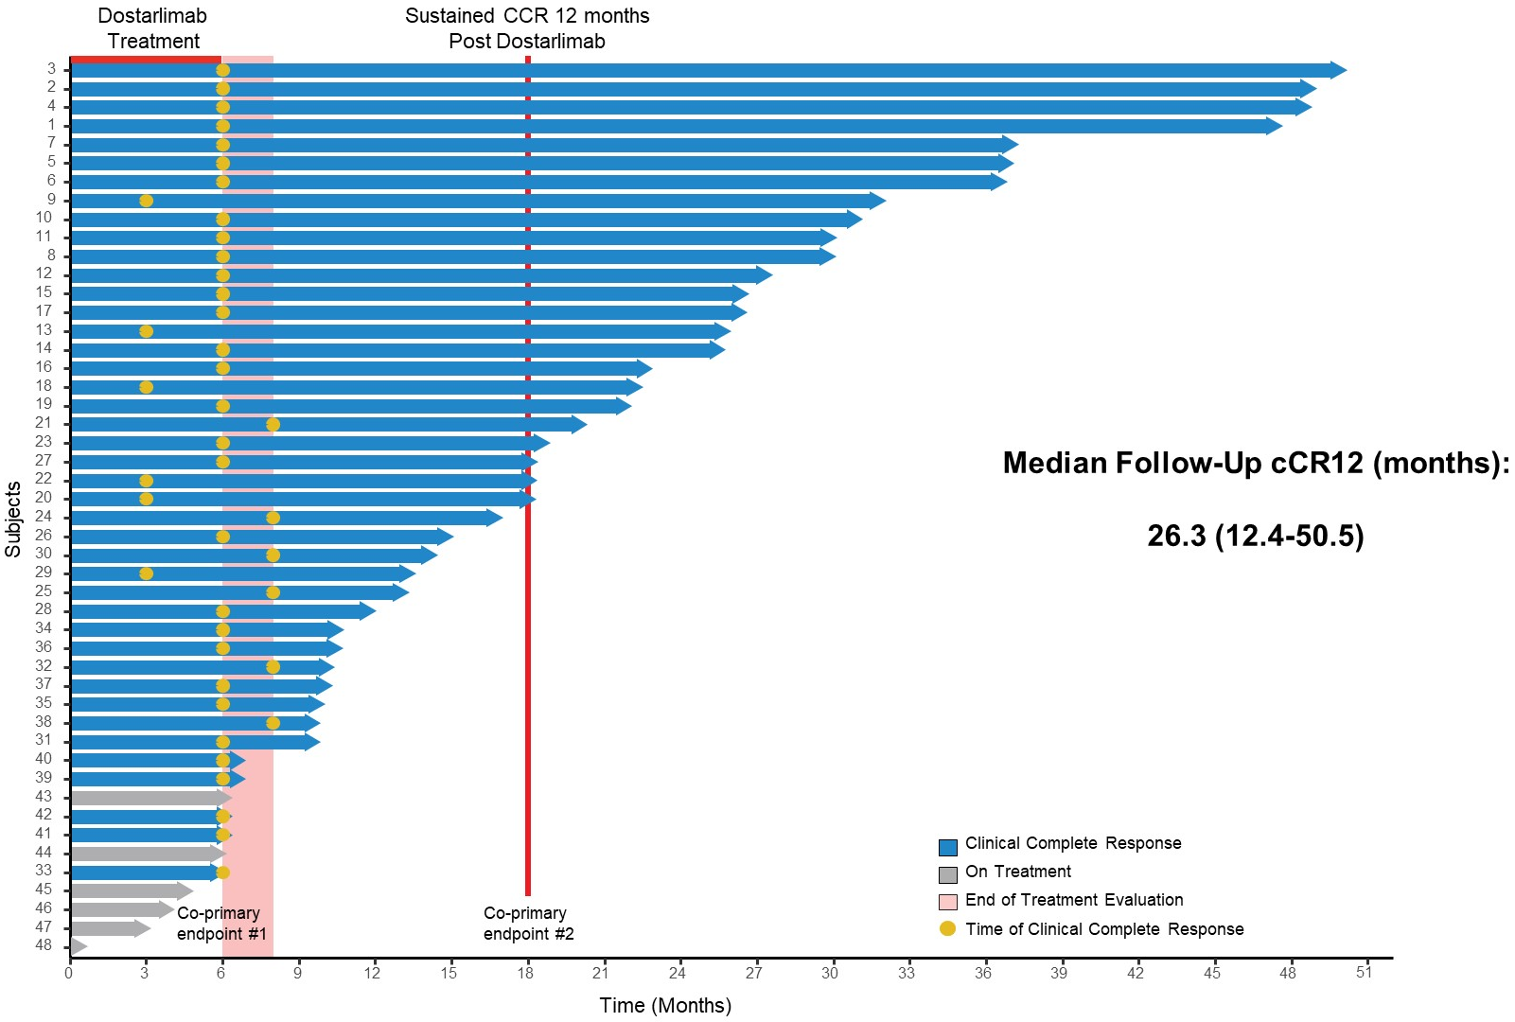
Slide 12
Update 2024 (42 patients)
Cercek, ASCO 2024

Slide 13
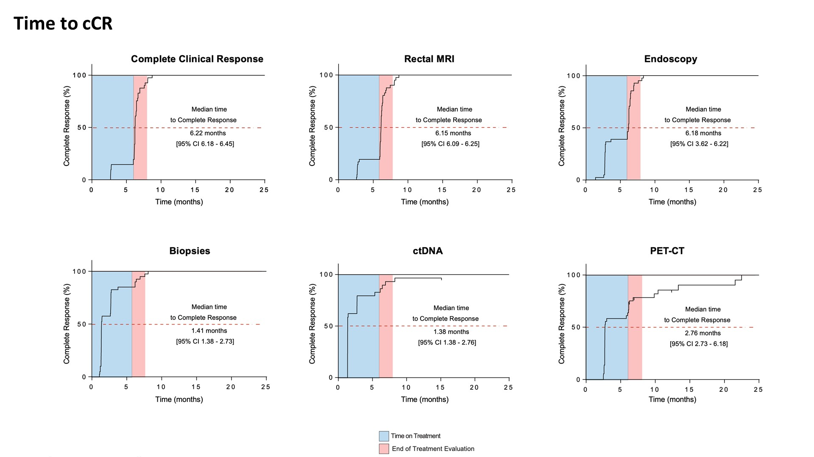
Time to clinical Complete Response
Cercek, ASCO 2024
Notes:
And what was actually the fastest in terms of an indicator of time to clinical complete response was circulating tumor DNA. So we used a tumor-informed assay with incredibly high sensitivity-- actually, 97% of patients had positive ctDNA at baseline and they cleared it incredibly quickly. At just 1.38 months was the median time to CCR. And more than half of the patients actually cleared it by the first evaluation at just six weeks.

Slide 14
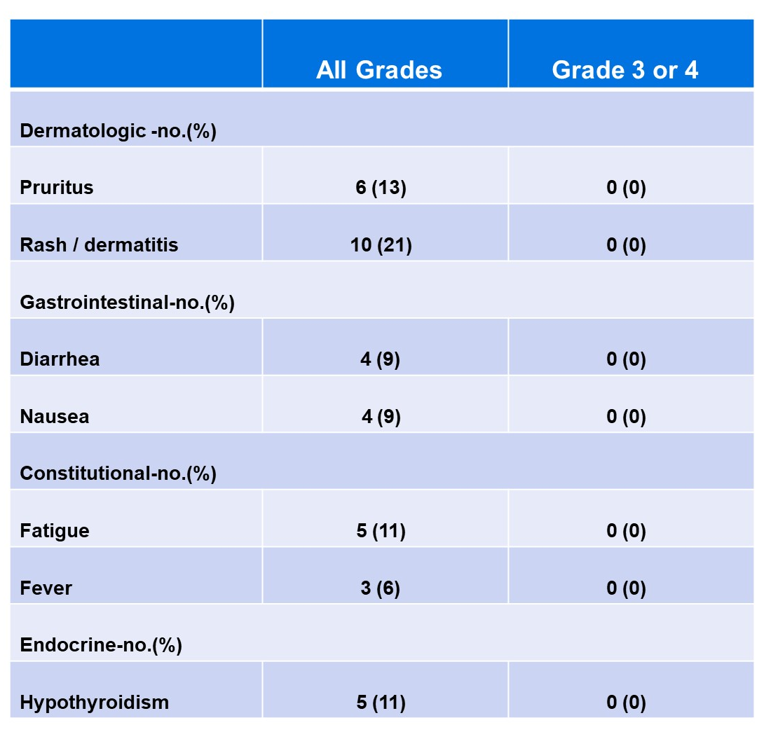
Adverse events
Cercek, ASCO 2022

Slide 15
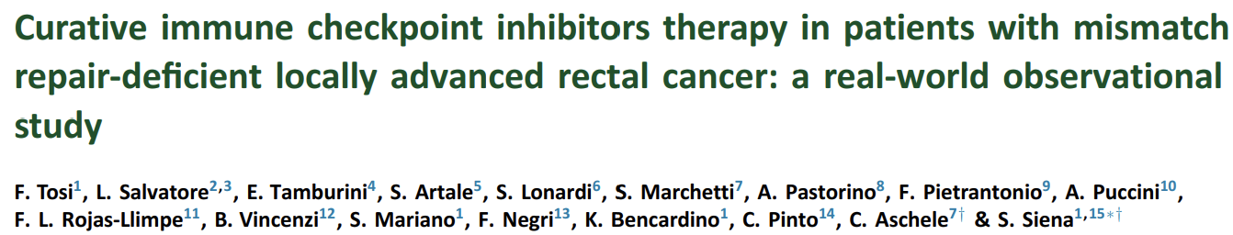
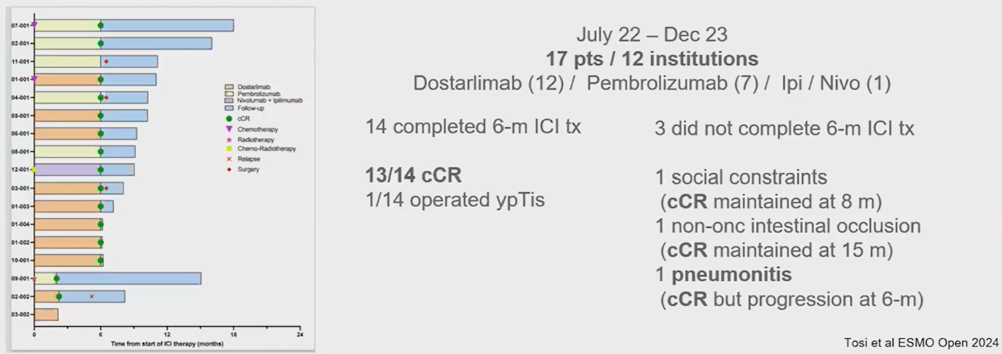

Slide 16
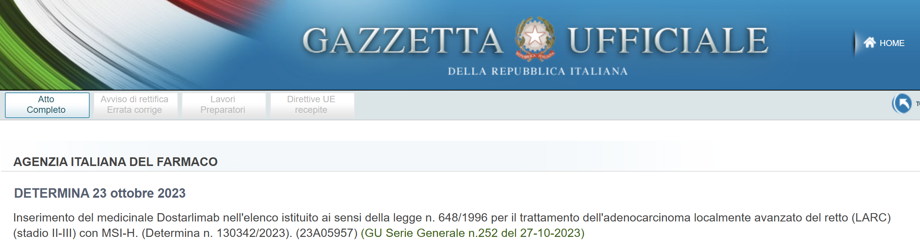

Slide 17
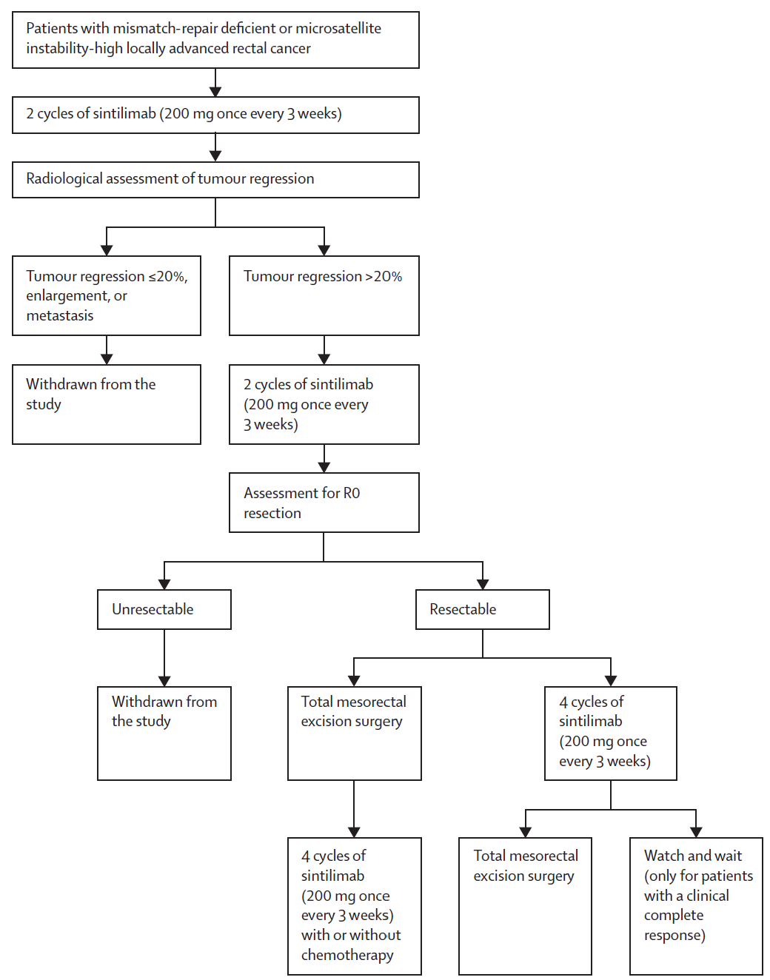
Sintilimab in MSI-H LARC
Chen, Lancet GH 2023
Notes:
Patients were treated with an initial two cycles of sintilimab followed by early radiographic assessment to make sure that they weren't having disease progression. And if they had at least 20% tumor regression, they could go on to further I-O therapy, and then ultimately to resection or nonoperative management. Some patients did receive adjuvant amlitelimab with or without chemotherapy, and some did go on to nonoperative management.

Slide 18
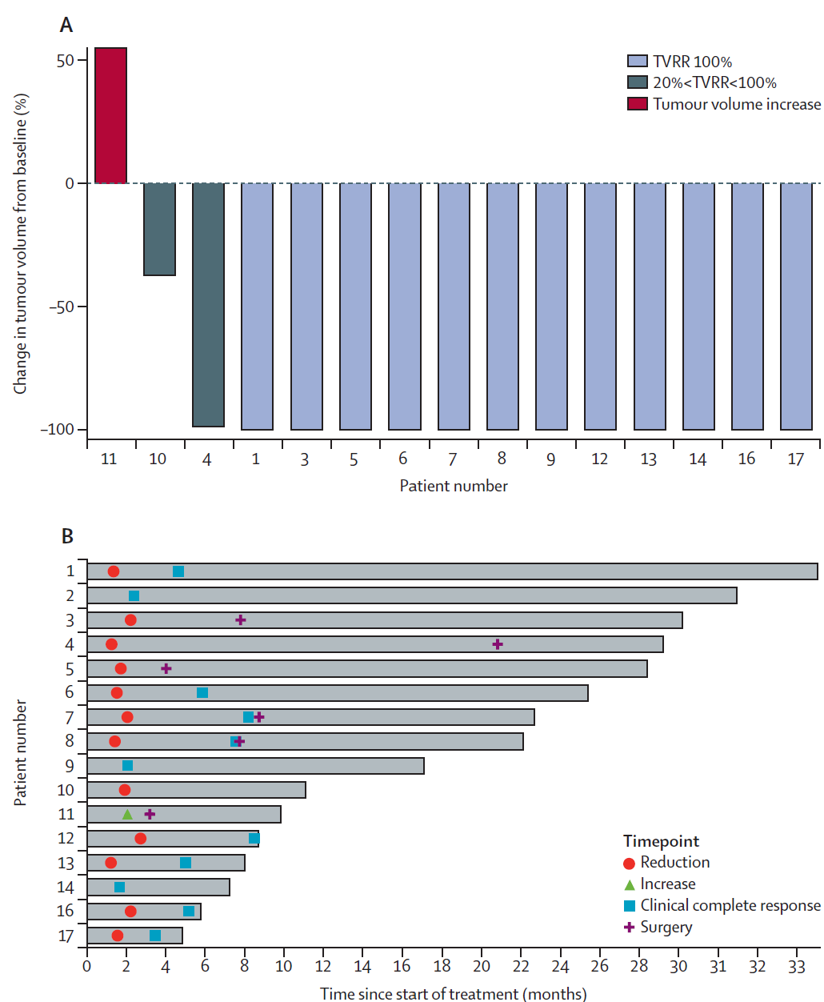
Sintilimab in MSI-H LARC
CR (pCR or cCR)= 75%; 9 pts with Ccr; 3/6 with pCR
Chen, Lancet GH 2023
Notes:
Nine of them went on to-- had achieved a clinical complete response that did not require surgery. Six did not achieve a clinical complete response, went on to surgery. Three of those six actually had a path CR, and one patient actually had primary progression on sintilimab therapy.

Slide 19
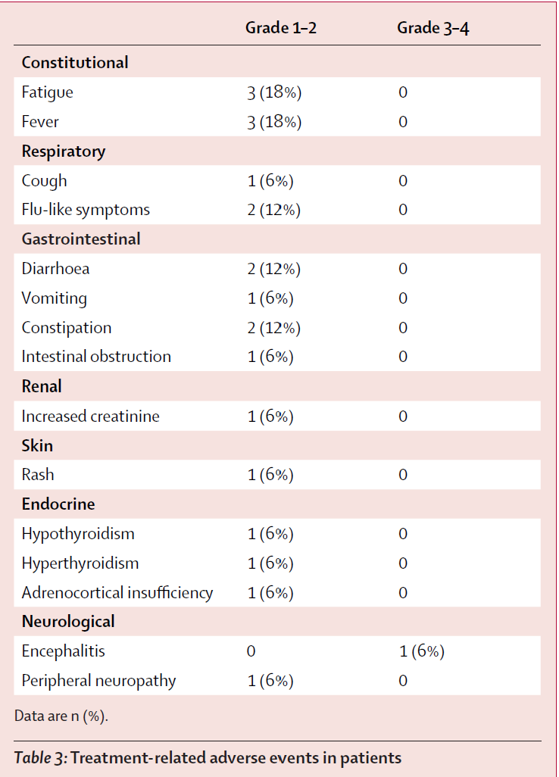
Sintilimab in MSI-H LARC
Chen, Lancet GH 2023

Slide 20
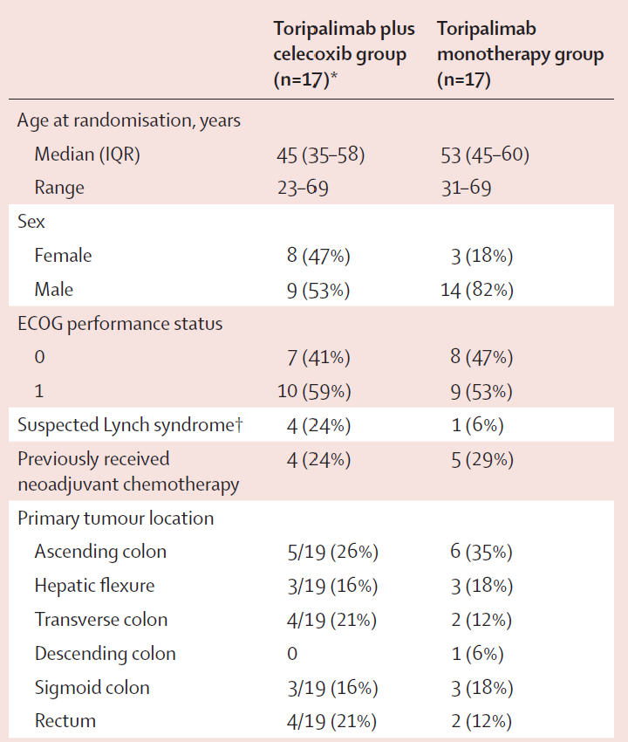
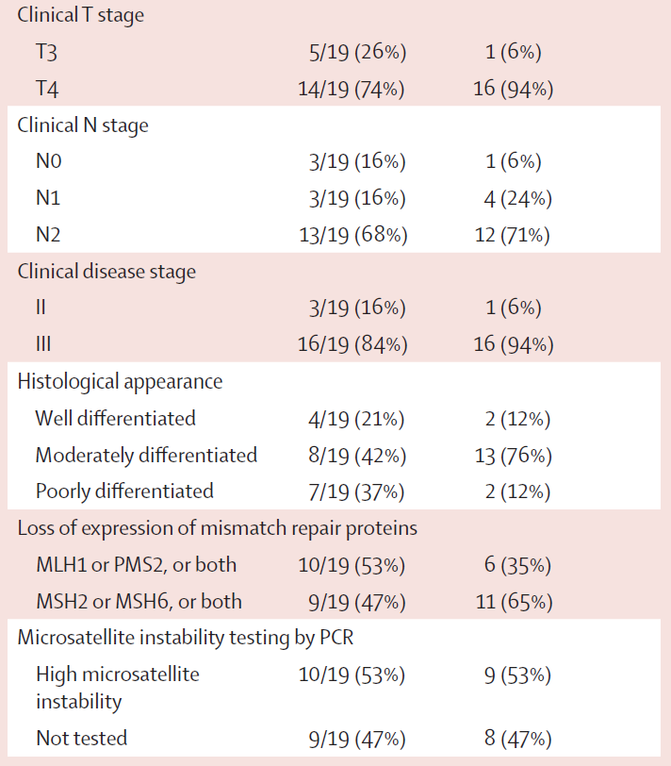
Toripalimab +/- Celecoxib in MSI-H localized CRC
Hu, Lancet GH 2022
Notes:
So another study that was looking at colorectal, so not specifically rectal, though a good proportion of patients did have rectal cancer, was the toripalimab plus or minus celecoxib study in MSI-high disease. These patients all were randomized to either toripalimab plus celecoxib or toripalimab monotherapy. They all did undergo surgery with curative intent.

Slide 21
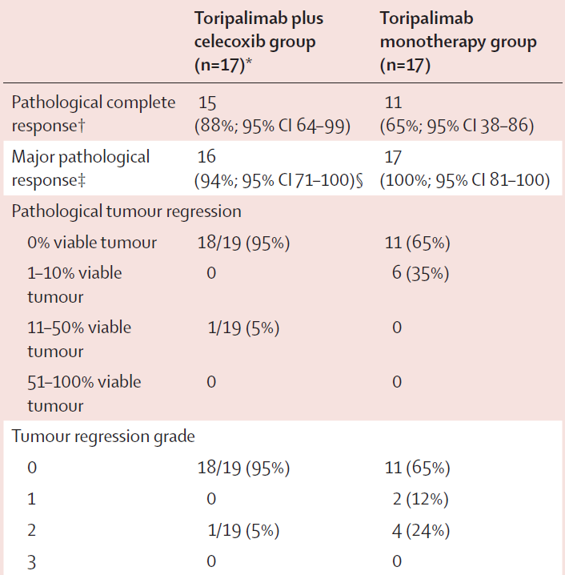
Toripalimab +/- Celecoxib in MSI-H localized CRC
Hu, Lancet GH 2022
Notes:
15 out of 17 patients, or 88%, achieved a path CR, and 65% in the monotherapy arm.

Slide 22
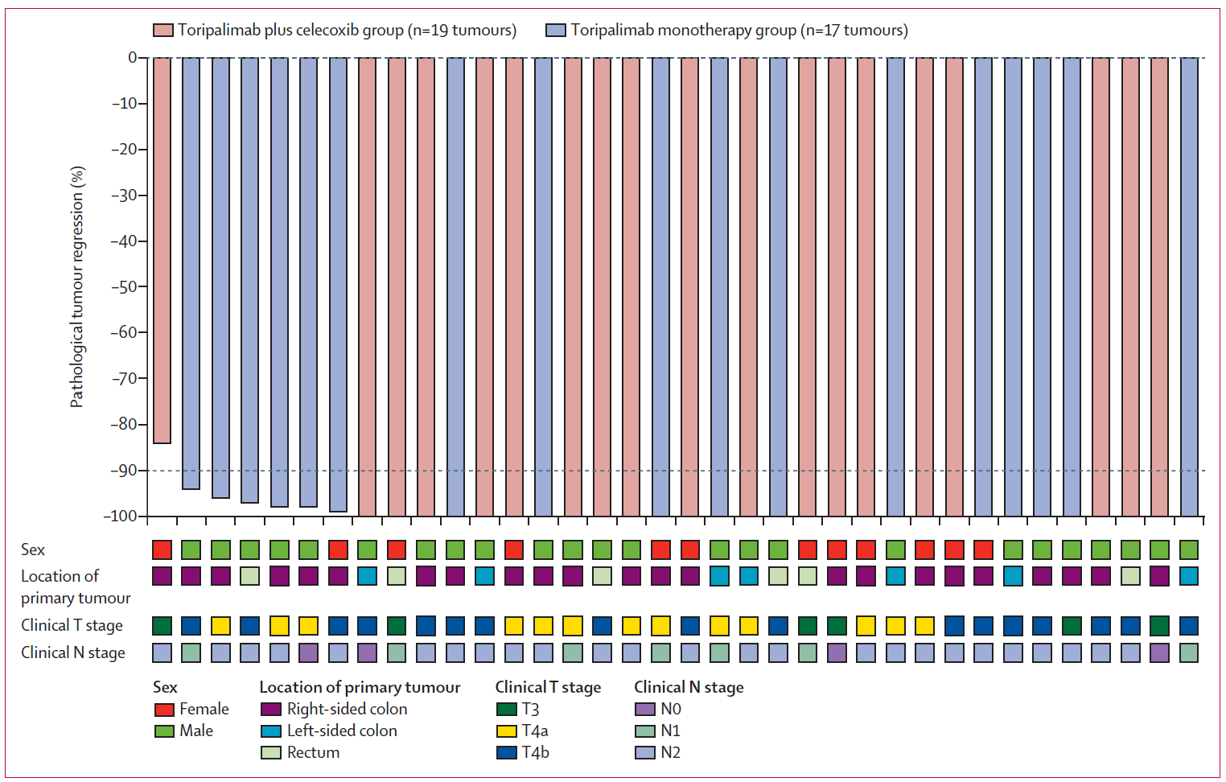
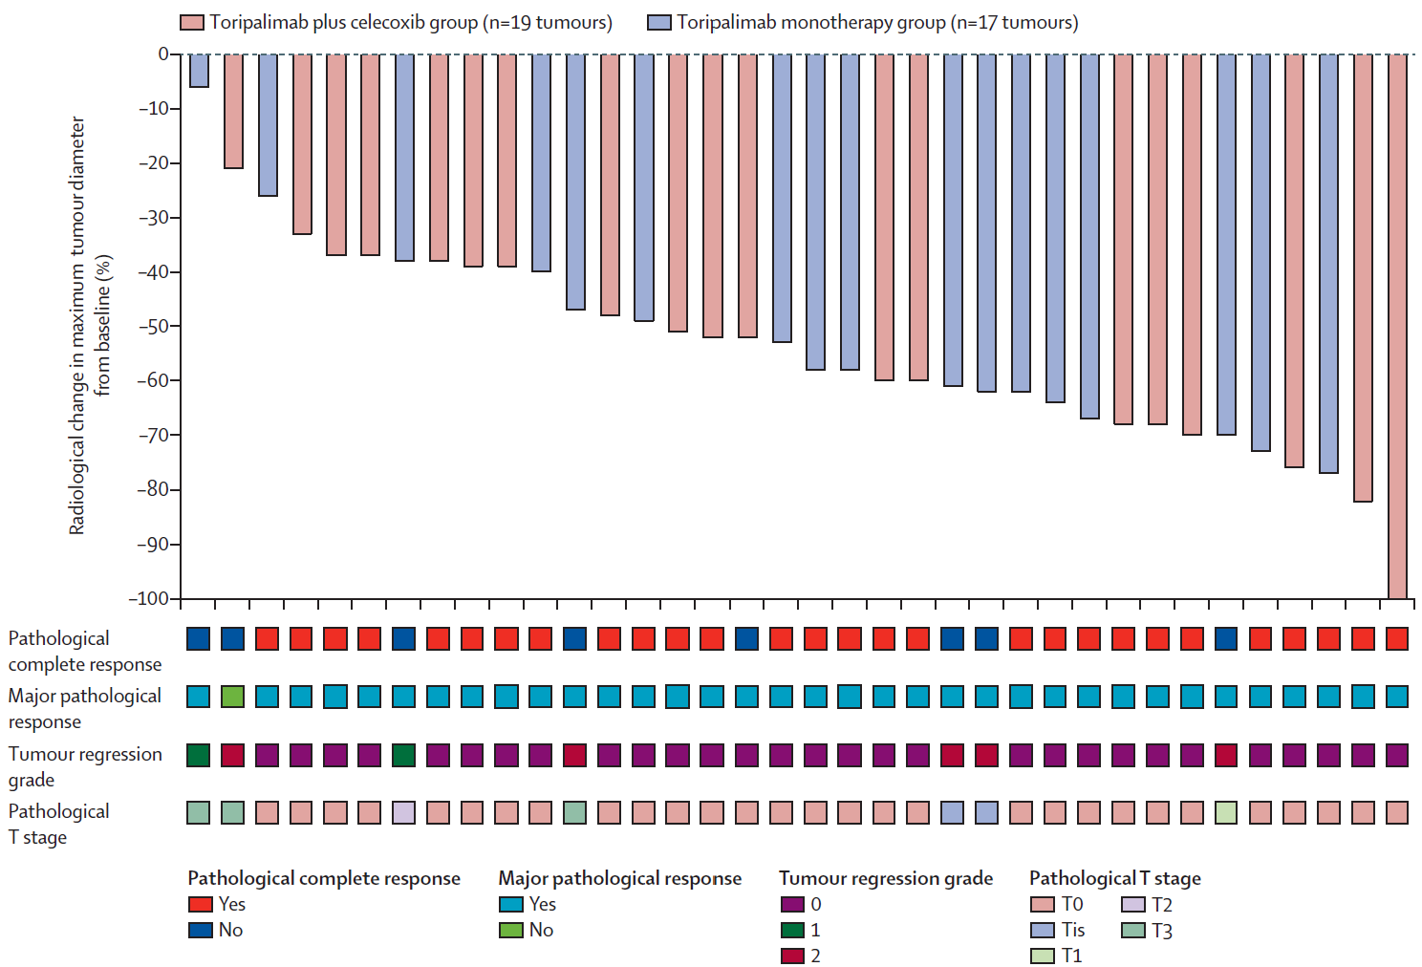
Toripalimab +/- Celecoxib in MSI-H localized CRC
Hu, Lancet GH 2022
Notes:
Differenze tra risultati istologici e radiologici

Slide 23
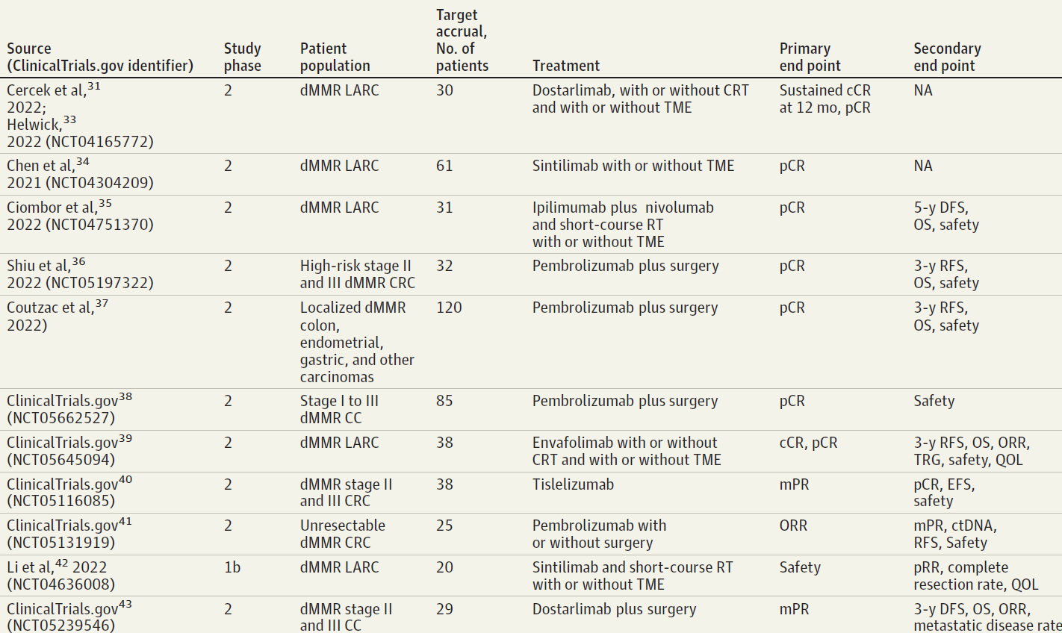
Ongoing trials for MSI-H localized CRC
Neoadjuvant Immune Checkpoint Inhibitor Therapy for Localized Deficient Mismatch Repair Colorectal Cancer A Review, Oluwadunni, JAMA Oncology 2023

Slide 24
Conclusions
Imperative to test for dMMR/MSI-H in patients with LARC
PD-1 blockade induces cCR in many MSI-H/dMMR patients
Generalizability? Differences in Lynch vs. non-Lynch?
Optimal duration of immunotherapy needed is unknown
Must complete enrollment of ongoing trials to determine long-term outcomes, generalizability

Slide 25
Grazie

